Slide 1

Online Surprise Gift Delivery System
Presented by: Satheeswaran Thusanth

Slide 2

Introduction
The online surprise gift delivery system is a user-friendly platform for selecting and sending surprise gifts.
Purpose: Enhance user experience with personalization, secure payments, and delivery scheduling.

Slide 3

Problem Statement
Traditional gift services lack personalization and surprise elements. Existing platforms do not allow scheduling, custom packaging, or anonymous gifting.

Slide 4

Project Scope
Develop a user-friendly system for choosing, customizing, and scheduling gift deliveries. Focus on reliability, security, and personalization.

Slide 5

Aim and Objectives
Aim
To create a feature-rich, seamless online platform for surprise gift deliveries.
Objectives:
Design a responsive, user-friendly interface.
Implement customization options.
Develop an efficient order management system.

Slide 6
Functional Requirements
• Gift Display with detailed descriptions and pricing.
• Customization options: personal messages, special packaging.
• Secure payment processing.
• Delivery scheduling.
• Notifications for order updates.

Slide 7

Modules
Admin Module: Manage products, orders, inventory, and customer queries.
Customer Module: Browse, customize gifts, schedule deliveries, and track orders.

Slide 8

Hardware & Software Requirements
Software: Windows 8+, HTML, CSS, JavaScript, Chrome/Firefox.
Hardware: Intel Core i5, 8GB RAM, 256GB SSD.

Slide 9
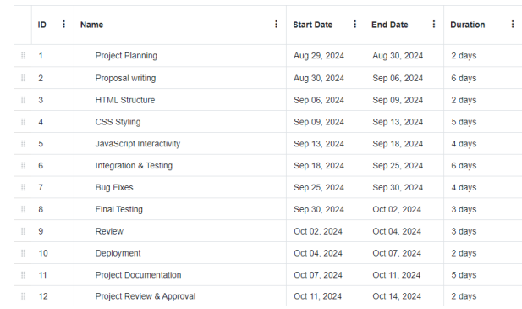
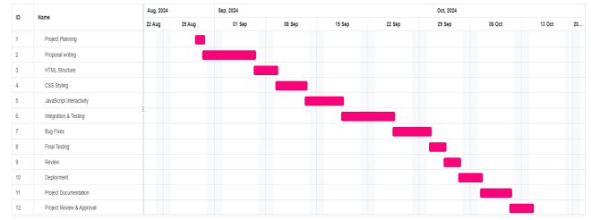
Project Schedule
A Gantt chart or timeline details the project's phases, including planning, design, development, testing, and deployment.

Slide 10

Conclusion
This system aims to streamline the gifting process, ensuring user satisfaction and fostering customer loyalty.

Slide 11

ANY QUESTION?

